Slide 1
Low-Performing Students WHY THEY FALL BEHIND AND HOW TO HELP THEM SUCCEED
Andreas Schleicher
Director for Education and Skills
OECD
February 2016

Slide 2
“LOW-PERFORMING” STUDENTS: What do we mean?

Slide 3
Low performers: Definitions in PISA
In PISA, Level 2 is considered the baseline level of proficiency in mathematics, reading and/or science.
In PISA, “low performers” are students who perform below the baseline Level 2 in mathematics, reading and/or science (i.e. they score at Level 1 or below).
Low performers can answer questions that provide clear directions and single information sources and connections. However, they typically cannot make more complex uses of information and reasoning.
Students demonstrate elementary skills to read and understand simple text and master basic mathematical and scientific concepts and procedures
Notes:
Option 2

Slide 4
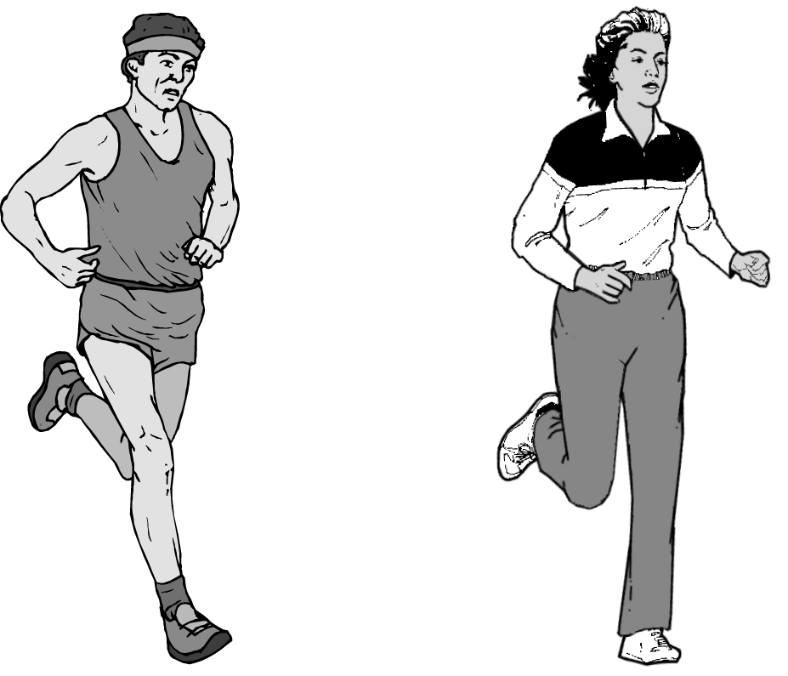
% students by country who answered correctly
Finland | 93
Hungary | 91
Russian Federation | 90
Slovenia | 89
Latvia | 88
Czech Republic | 88
Iceland | 88
Greece | 87
Portugal | 87
Croatia | 86
Spain | 86
Italy | 85
Liechtenstein | 85
Hong Kong- China | 85
Australia | 85
Canada | 84
Denmark | 84
Serbia | 84
New Zealand | 84
Belgium | 84
Poland | 84
Netherlands | 84
Tunisia | 83
Slovak Republic | 83
United Kingdom | 83
OECD average | 82
Sweden | 82
Switzerland | 82
Chile | 82
Turkey | 82
Thailand | 81
Macao-China | 81
Bulgaria | 81
Jordan | 80
Israel | 80
Japan | 80
Luxembourg | 79
Austria | 79
France | 79
Mexico | 78
Germany | 77
Estonia | 77
Chinese Taipei | 77
Norway | 76
United States | 76
Romania | 76
Montenegro | 76
Ireland | 76
Argentina | 75
Lithuania | 73
Azerbaijan | 72
Brazil | 71
Korea | 68
Colombia | 63
Kyrgyzstan | 57
Indonesia | 54
Qatar | 53
Regular but moderate physical exercise is good for our health
Answering this question correctly corresponds to a difficulty of 386 score points on the PISA science scale. Across countries, 82% of students answered correctly. This question assesses students’ competency of explaining phenomena scientifically.
What happens when muscles are exercised? Circle “Yes” or “No” for each statement.
Does this happen when muscles are exercised? | Yes or No?
Muscles get an increased flow of blood. | Yes / No
Fats are formed in the muscles. | Yes / No
Answering this question correctly corresponds to a difficulty of 386 score points on the PISA science scale. Across OECD countries, 82% of students answered correctly. This question assesses students’ competency of explaining phenomena scientifically.

Slide 5
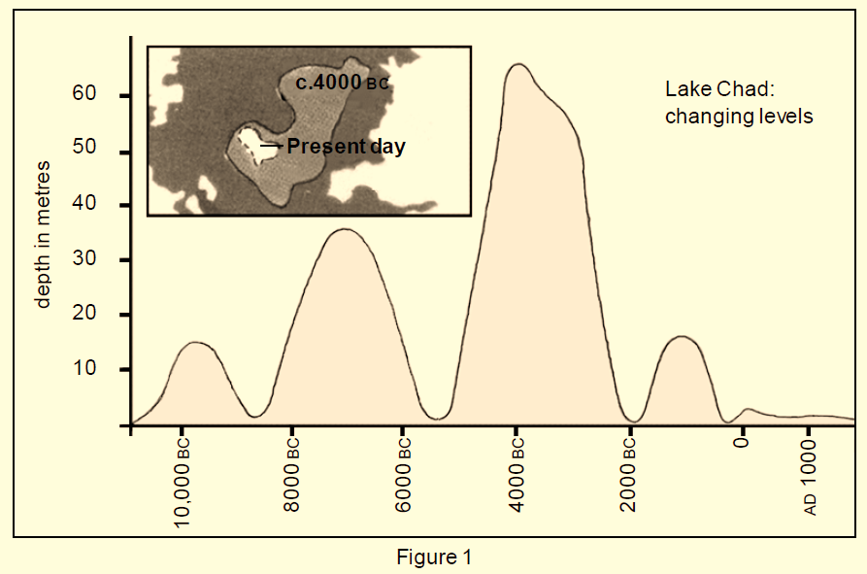
Figure 1 shows changing levels of Lake Chad, in Saharan North Africa. Lake Chad disappeared completely in about 20,000BC, during the last Ice Age. In about 11,000 BC it reappeared. Today, its level is about the same as it was in AD 1000.

Slide 6
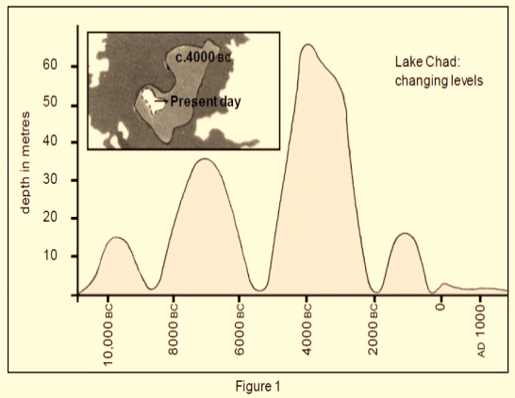
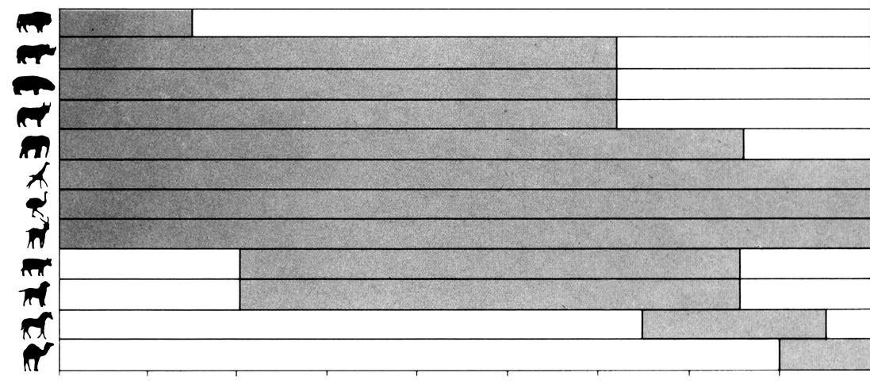
Figure 2 shows Saharan rock art (ancient drawings or paintings found on the walls of caves) and changing patterns of wildlife
% students by country who answered correctly
Finland | 87
Hungary | 85
Korea | 85
Netherlands | 84
Austria | 83
Sweden | 82
Spain | 82
France | 82
Belgium | 81
Czech Republic | 80
Denmark | 80
Canada | 80
Germany | 80
Australia | 80
Liechtenstein | 79
Japan | 79
Italy | 79
Switzerland | 78
New Zealand | 78
Portugal | 78
OECD average | 77
United Kingdom | 76
Poland | 73
Ireland | 72
Luxembourg | 72
Norway | 72
United States | 71
Iceland | 70
Greece | 68
Latvia | 68
Brazil | 63
Russian Federation | 59
Mexico | 49
Saharan rock art and changing patterns of wildlife
buffalo
rhinoceros
hippopotamus
aurochs
elephant
giraffe
ostrich
gazelle
Answering this question correctly corresponds to a difficulty of 397 score points on the PISA reading scale. Across countries, 77% of students answered correctly. To do so, they interpreted the text correctly.
cattle
dog
horse
camel
8000 BC
7000 BC
6000 BC
5000 BC
4000 BC
3000 BC
2000 BC
1000 BC
0
AD 1000
Figure 2
Question: Figure 2 is based on the assumption that:
A. the animals in the rock art were present in the area at the time they were drawn.
B. the artists who drew the animals were highly skilled.
C. the artists who drew the animals were able to travel widely.
D. there was no attempt to domesticate the animals which were depicted in the rock art.

Slide 7
% students by country who answered correctly
Liechtenstein | 95
Macao- China | 93
Finland | 90
France | 89
Hong Kong-China | 89
Sweden | 89
Austria | 87
Switzerland | 87
Belgium | 87
Czech Republic | 87
Canada | 86
Slovak Republic | 86
Iceland | 86
Denmark | 85
Russian Federation | 85
Luxembourg | 85
Netherlands | 85
Hungary | 84
Ireland | 83
Germany | 83
Australia | 81
Korea | 81
Latvia | 80
New Zealand | 80
OECD average | 80
Japan | 79
Spain | 79
Serbia | 79
Norway | 77
Poland | 77
Portugal | 74
United Kingdom | 74
Greece | 73
Italy | 71
Uruguay | 71
Mexico | 60
Thailand | 60
Turkey | 60
Indonesia | 59
Tunisia | 55
United States | 54
Brazil | 37
Mei-Ling from Singapore was preparing to go to South Africa for 3 months as an exchange student. She needed to change some Singapore dollars (SGD) into South African rand (ZAR).
Question: Mei-Ling found out that the exchange rate between Singapore dollars and South African rand was:
1 SGD = 4.2 ZAR
Answering this question correctly corresponds to a difficulty of 406 score points on the PISA mathematics scale. Across countries, 80% of students answered correctly. To answer the question correctly students have to draw on skills from the reproduction competency cluster.
Mei-Ling changed 3000 Singapore dollars into South African rand at this exchange rate.
How much money in South African rand did Mei-Ling get?
12600 zAR
Answer: ________________________

Slide 8
Proficiency levels in mathematics, reading and science
 | Proficiency level | Lowest score point in the level
 |  | Mathematics | Reading |  | Science
At or above the baseline proficiency | Level 6 | 669 | 698 |  | 708
 | Level 5 | 607 | 626 |  | 633
 | Level 4 | 545 | 553 |  | 559
 | Level 3 | 482 | 480 |  | 484
 | Level 2 (baseline) | 420 | 407 |  | 410
Low-performing students (below baseline) | Level 1 | 358 | Level 1a | 335 | 335
 |  |  | Level 1b | 262
 | Below Level 1 | . | . |  | .
Low-performing students in mathematics are those who score below 420 points
Low-performing students in reading are those who score below 407 points
Low-performing students in science are those who score below 410 points

Slide 9
Low performance at age 15 Why It Matters
Notes:
Low student performance at age 15 matters because it has great consequences for individual students and for the economy as a whole

Slide 10
Consequences for low performers
Risk of dropping out of school: lower educational attainment
Low-skills tend to be persistent over time, from age 15 into early adulthood
Limited access to better-paying and more-rewarding- jobs
Poorer health and less social political participation
Notes:
Evidence comes from PISA longitudinal studies, PISA-PIACC studies, and PIACC.

Slide 11
Consequences for education systems
%
Reducing low performance is an effective way to improve overall performance
More low performers
Higher mean score
At high levels of performance,
reducing % of low performers further is challenging
Source: Figure 1.10.
Notes:
There is a strong correlation between the mean level of performance and the share of low performers.
There is a strong correlation between
the % of low performers in mathematics
and mean score in mathematics

Slide 12
Low performance compromises equality in educational opportunity
Low performers come more frequently from socio-economically disadvantaged families
Percentage of low performers
Source: Figure 2.2.

Slide 13
The economic value of eliminating low performance
Value of improvement in terms of current GDP over working life of today’s 15-year-olds
The increase in GDP among high income countries would still exceed total current spending on schooling

Slide 14
The economic value of eliminating low performance

Slide 15
Inclusive growth
Achieving universal basic skills will make economic growth more inclusive
The increase in average earnings from attaining universal basic skills amounts to some 4.2% across the 28 countries with universal enrolment in secondary schools.
This increase is accompanied by a 5.2% average reduction in the achievement-induced part of the standard deviation of earnings
Universal basic skills will also expand the size of the economy, and thus differs from simple tax and redistribution schemes that might change income distribution but would not add to societal output
Policies to improve knowledge capital will also promote inclusion and a more equitable income distribution

Slide 16
LOW-PERFORMING STUDENTS: HOW MANY ARE THERE?

Slide 17
All countries participating in PISA have a sizable share of low performers
Percentage of low performers (Level 1 or below) in Mathematics
%
50% or more:
16 countries
10% or less:
4 countries / economies
Source: Figure 1.5.

Slide 18
All countries participating in PISA have a sizable share of low performers
Percentage of low performers (Level 1a or below) in reading
%
50% or more:
10 countries
10% or less:
8 countries / economies
Source: Figure 1.5.

Slide 19
All countries participating in PISA have a sizable share of low performers
Percentage of low performers (Level 1 or below) in science
%
50% or more:
10 countries
10% or less:
10 countries or economies
Source: Figure 1.5.

Slide 20
Overlap of low performance across subjects (OECD average)
Low performers in at least 1 subject
28%
Source: Figure 1.1.

Slide 21
What this means in absolute terms, across OECD countries
Overlap of low performers in mathematics, reading and science
Low performers in at least one subject:
4 482 202
Mathematics only
948 423
Reading
and mathematics
391 857
Mathematics and science
599 294
Reading, mathematics and science
1 876 403
Science only
216 662
Reading and science
144 821
Reading only
304 742
Source: Figure 1.1.

Slide 22
What this means in absolute terms, across all countries and economies
Overlap of low performers in mathematics, reading and science
Low performers in at least one subject:
12 905 826
Mathematics only
2 127 165
Reading
and mathematics
1 035 845
Mathematics and science
1 782 032
Reading, mathematics and science
6 463 602
Reading and
science
353 331
Science only
483 912
Reading only
659 939
Source: Figure 1.1.

Slide 23
Uneven progress in reducing low performance in mathematics
Source: Figure 1.11.

Slide 24
Diversity of cases shows that reducing low performance is possible anywhere
Reduced their share of low performing students in…
Mathematics (between 2003 and 2012) | Reading (between 2000 and 2012) | Science (between 2006 and 2012)
OECD (6 countries) | OECD (6 countries) | OECD (12 countries)
Germany Mexico Italy Poland Portugal Turkey | Germany Mexico Italy Japan Poland Turkey | Estonia, Ireland Israel, Italy Japan, Korea Poland, Portugal Spain, Switzerland Turkey, United States
Partners (3 countries) | Partners (4 countries and economies) | Partners (8 countries and economies)
Brazil Russian Federation Tunisia | Hong Kong-China Russian Federation Thailand Tunisia | Brazil, Hong Kong-China Latvia, Lithuania Qatar, Romania Thailand, Tunisia
Notes:
Many say that reducing low performance is too hard. But PISA shows there are many countries and very diverse where this has happened.
Diversity in: average income levels, in mean performance levels, in initial share of low performers, in economic trends during the period…
Big role for education policy and practice in tacking low performance.

Slide 25
What are the main risk factors of low performance at age 15?
Low Performance
Students
Socio-economic status
Demographic background
Schools
Allocation of resources
Systems
Progress through education
School composition
Attitudes and behaviours
Learning environment
Resources and administration
Stratification policies
Governance
Notes:
Poor performance at age 15 is not the result of any single risk factor, but rather of a combination and accumulation of various barriers and disadvantages that affect students throughout their lives.

Slide 26
Students’ background AND LOW PERFORMANCE

Slide 27
Socio-economic status
Odds ratios higher than 1.0 mean that disadvantaged students are more likely to be low performers than advantaged students
More likely to be low performer:
socio-economically disadvantaged students
More likely to be low performer
Source: Figure 2.3.

Slide 28
Gender (OECD average)
Boys are more often low performers in reading and science
Girls are more often low performers in mathematics
Source: Figure 2.4.
Notes:
Which figure?

Slide 29
Immigrant background
More likely to be low performer:
students with an immigrant background
Source: Figure 2.7.

Slide 30
Family structure
More likely to be low performers:
Students in single-parent families
Source: Figure 2.10.

Slide 31
Geographic location
More likely to be low performers:
students attending schools in rural areas
Source: Figure 2.12.

Slide 32
Students’ progress through education AND LOW PERFORMANCE

Slide 33
Pre-primary education
More low performers among students with no pre-primary education
Source: Figure 2.13.
Notes:
Percentage-point differences between the share of low-performing students who had not attended pre-primary school and those who had attended for at least one year are not statistically significant in Albania, Estonia, Ireland and Latvia.

Slide 34
Grade repetition
More low performers among students who had repeated a grade
Source: Figure 2.15.
Notes:
Statistically significant percentage-point differences between the share of low-performing students who have repeated a grade and those who have not repeated a grade are marked in a darker tone.

Slide 35
Program orientation
More low performers among students enrolled in vocational programmes
Source: Figure 2.17.

Slide 36
The risk of low performance is cumulative and multidimensional
Socio-economic status
Demographic background
Progress through education
Cumulative probability of becoming a low performer
Source: Figure 2.19.

Slide 37
STUDENTS’ ATTITUDES AND BEHAVIORS AND LOW PERFORMANCE

Slide 38
Missing learning opportunities and low performance
Percentage of students who had skipped school at least once in the two weeks prior to the PISA test
Source: Figure 3.1.
Notes:
In countries where truancy is marginal (Liechtenstein, Shanghai-China, Iceland, Japan, Ireland, Netherlands, Korea, Germany, Czech Republic…), there are less low performers in mathematics. Only exceptions are Colombia and Chile.

Slide 39
Missing learning opportunities is associated with low performance in mathematics
Across OECD countries
Students who had skipped some classes "at least once"
are twice as likely to be low performers as students who had "never" skipped classes
More likely to be low performer
Source: Figure 3.2.

Slide 40
More hours spent doing homework is associated with a lower risk of low performance, at least up to a point
Less likely to be low performers
Students who spend 6 hours on homework per week are
70% less likely to be low performers than students who do no homework
Source: Figure 3.4.
Notes:
Just a few hours of homework per week can make a big difference. Decreasing association; large “benefits” until 5/6 hours, no further gains thereafter.

Slide 41
Low performers say they are less perseverant
Source: Figure 3.8.
Notes:
Remember is based on students’ self-reports

Slide 42
Participation in mathematics-related activities and low performance
When activities are social and recreational, low performers participate more
When activities require higher-order skills, top performers participate more
Source: Figure 3.5.
Notes:
When activities are recreational, involve games and are often proposed by schools/parents (reverse causality), low performers are often more likely to participate. When they involve high-order skills (“help friends” “talk about mathematics problems”, “program computers”, “mathematics competitions”), top performers are more likely to participate than moderate or low performing students.

Slide 43
Low performers in mathematics perceive their effort to be unproductive
Low performers need support
when preparing for exams and doing homework
When questions relate to invested effort: differences are small
When questions relate to the outcomes of these efforts: differences are large
Source: Figure 3.6.
Notes:
Less difference when questions are about “effort” (“work hard”, “study hard”) than about the “outcomes” of these efforts (“finish homework” and “being prepared for exams”) >>> Need support when preparing for exams and doing homework

Slide 44
Doing extracurricular activities in mathematics is associated with greater mathematics interest
Low performers that participate in extracurricular mathematics are more interested in mathematics
Source: Figure 3.11.

Slide 45
What matters for students’ attitudes towards school and learning is their performance, not their socio-economic status
ESCS refers to the PISA index of economic, social and cultural status
Source: Figure 3.18.
Notes:
Exception: Sense of belonging at school (higher ESCS > stronger sense of belonging at school)

Slide 46
Low performers' attitudes towards school and learning, by school subject
Early detection
Disengaged students
Source: Figure 3.19.
Notes:
Important “jumps”: From “0” subjects to “1” (for school attendance and self-efficacy) and from “2” to “3” (for school attendance). Useful to identify students who are completely disengaged…solutions may need to go beyond school walls.

Slide 47
SCHOOLS AND LOW PERFORMANCE

Slide 48
Socio-economic profile of schools
Low performers tend to have school peers of lower
socio-economic status
Source: Figure 4.4.

Slide 49
Socio-economic inclusion in schools
%
More low performers
More socio-economic inclusion in schools
Fewer low performers in countries with more social inclusion in schools
%
Source: Figure 5.1a.
Notes:
Notes: The index of socio-economic inclusion shows the extent to which students' socio-economic status varies within schools, measured as a percentage of the total variation in students' socio-economic status across the school system.
The relationship is statistically significant (p < 0.10).
Only countries and economies with available data are included.

Slide 50
Socio-economic inclusion in schools
%
More top performers
More top performers in countries with more social inclusion in schools
More socio-economic inclusion in schools
%
Source: Figure 5.1b.
Notes:
Notes: The index of socio-economic inclusion shows the extent to which students' socio-economic status varies within schools, measured as a percentage of the total variation in students' socio-economic status across the school system.
The relationship is statistically significant (p < 0.10).
Only countries and economies with available data are included.

Slide 51
Teachers’ expectations
More likely to be low performers: students in schools where teachers have low expectations
Source: Figure 4.5.

Slide 52
Ability grouping for math classes
More likely to be low performers: students in schools with more ability grouping for math classes
Source: Figure 4.6.

Slide 53
Teachers’ support
More likely to be low performers: students in schools where there is less teacher support
Source: Figure 4.7.

Slide 54
Teachers’ morale
More likely to be low performers: students in schools where teachers’ morale is lower
Source: Figure 4.8.

Slide 55
Teachers’ absenteeism
More likely to be low performers: students in schools with more teachers’ absenteeism
Source: Figure 4.9.

Slide 56
Mathematics related extracurricular activities
More likely to be low performers: students in schools with fewer math-related extracurricular activities
Source: Figure 4.10.

Slide 57
Parental pressure for high achievement and low performance
More likely to be low performers: students in schools where there is less parental pressure
Source: OECD, Figure 4.12.

Slide 58
Quality of educational resources at school
More likely to be low performers: students in schools with lower-quality educational resources
Source: Figure 4.13.

Slide 59
School resources: infrastructure, teachers, materials, class size
System-level correlation (all countries/economies in PISA 2012)
Quality of physical infrastructure
Teacher shortage
Class size
Quality of schools' educational resources
Source: Figure 5.2.
Notes:
Notes: Class size has been standardised so that the OECD average is zero and the standard deviation across OECD countries is one.
A significant relationship (p < 0.10) is shown by a thicker line.
Only countries and economies with available data are included.

Slide 60
School resources by country’s resources level
System-level correlation (all countries/economies in PISA 2012)
Quality of physical infrastructure
(below OECD average)
Quality of schools' educational resources
(below OECD average)
Quality of schools' educational resources
(above OECD average)
Quality of physical infrastructure
(above OECD average)
Source: Figure 5.3.
Notes:
Chart shows that relationship is different before and after countries reach a certain level of investment in schools.
A significant relationship (p < 0.10) is shown by a thicker line.
Only countries and economies with available data are included.

Slide 61
School resources: low and top performers
System-level correlation (all countries/economies in PISA 2012)
Quality of physical infrastructure
and low performers
Quality of schools'
educational resources
and low performers
Quality of schools‘
educational resources
and top performers
Quality of physical infrastructure
and top performers
Source: Figure 5.4.
Notes:
Note: All relationships are significant (p < 0.10).

Slide 62
Equity in resources across schools
System-level correlation (all countries/economies in PISA 2012)
Equity in resource allocation
and low performers
Equity in resource allocation
and low performers, after accounting for the quality of schools' educational resources
Equity in resource allocation
and top performers,
after accounting for the
quality of schools' educational resources
Equity in resource allocation
and top performers
Source: Figure 5.5.
Notes:
Notes: A significant relationship (p < 0.10) is shown by a thicker line.
Only countries and economies with available data are included.
Equity in resource allocation refers to the difference in the index of quality of schools’ educational resources between socio-economically advantaged and disadvantaged schools.

Slide 63
School autonomy
System-level correlation (all countries/economies in PISA 2012)
School responsibility for curriculum and assessment
and low performers
School responsibility for resource allocation
and low performers
School responsibility for curriculum and assessment
and top performers
School responsibility for resource allocation
and top performers
Source: Figure 5.6.
Notes:
Notes: A significant relationship (p < 0.10) is shown by a thicker line.
Only countries and economies with available data are included.

Slide 64
School type: Private government-independent
Students in
private- independent
schools are...
...more likely
to be low performers than students in public schools
… less likely to be low performers
Source: Figure 4.15, Panel A.

Slide 65
School type: Private government-dependent
Students in
private- dependent
schools are...
...more likely
to be low performers than students in public schools
… less likely to be low performers
Source: Figure 4.15, Panel B.

Slide 66
School type
System-level correlation (all countries/economies with data in PISA 2012)
Students enrolled in private-independent schools
Students enrolled in public schools
Students enrolled in private-dependent schools
Source: Figure 5.7.
Notes:
Notes: A significant relationship (p < 0.10) is shown by a thicker line.
Only countries and economies with available data are included.

Slide 67
School system structure (1)
System-level correlation (all countries/economies with data in PISA 2012)
Vertical stratification
Ability grouping within schools
Between-school horizontal stratification
Source: Figure 5.11.
Notes:
Notes: A significant relationship (p < 0.10) is shown by a thicker line.
The index of vertical stratification is based on the degree of variation in the grade levels in which 15-year-old students are enrolled.
The index of ability grouping within schools is based on the prevalence of ability grouping within schools across the school system.
The index of between-school horizontal stratification is based on five indicators: the number of education tracks, the age at which students are selected into those tracks, the prevalence of vocational programmes, the academic selectivity of the school, and school transfer rates.
Only countries and economies with available data are included.

Slide 68
School system structure (2)
Percentage-point difference of low performers in mathematics
per unit increase in the indices cited along the horizontal axis
Source: Figure 5.13.
Notes:
Notes: Statistically significant percentage-point differences are marked in a darker tone.
The index of vertical stratification is based on the degree of variation in the grade levels in which 15-year-old students are enrolled.
The index of ability grouping within schools is based on the prevalence of ability grouping within schools across the school system.
The index of between-school horizontal stratification is based on five indicators: the number of education tracks, the age at which students are selected into those tracks, the prevalence of vocational programmes, the academic selectivity of the school, and school transfer rates.
Only countries and economies with available data are included.

Slide 69
A policy framework for tackling student low performance

Slide 70
Summary: Risk Factors of Low Performance
Students
Socio-economic status
Demographic background
Progress through education
Attitudes and behaviours
Socio-economic disadvantage
Girls (math),
Boys (reading and science)
Immigrant, language minority, rural areas
Single parent family
Lack of pre-primary
Grade repetition
Vocational programme
Missing classes
Low perseverance
Notes:
Poor performance at age 15 is not the result of any single risk factor, but rather of a combination and accumulation of various barriers and disadvantages that affect students throughout their lives.

Slide 71
Summary: Risk Factors of Low Performance
Schools
School composition
Learning environment
Resources and administration
Concentration of disadvantaged students
Low expectations for students
Unsupportive teachers,
low teacher morale
Lack of after-school opportunities
Lack of qualified teachers
Lack of quality educational resources
Uninvolved parents and communities
More ability grouping
Notes:
Poor performance at age 15 is not the result of any single risk factor, but rather of a combination and accumulation of various barriers and disadvantages that affect students throughout their lives.

Slide 72
For more information:
Thanks!
www.oecd.org/pisa
Andreas.SCHLEICHER@oecd.org
Daniel.SALINAS@oecd.org
Alfonso.ECHAZARRA@oecd.org

